Slide 1
Mid-year Progress Video
#127: A Pedagogic IDE
Yulia Pechorina and Keith Anderson
Notes:
Welcome to the mid year progress video for project 127: a pedagogic ide.
I'm Keith and I'll be presenting with Yulia.
We are building a web-based IDE to assist students with problem solving.

Slide 2
Part 1: Project Setup
Part 2: Firebase Project Setup
Part 3: Demo
Agenda
Keith Anderson
Notes:
First, Yulia will cover the setup of our project.
Second, I'll talk about the setup of Firebase.
Last, we will present a demo of our application so far, and talk a little about how it was designed and implemented.

Slide 3


Project Setup
Technology Stack:
React
Typescript
Yulia Pechorina
Notes:
The first step in developing our IDE was setting up the project.
We chose to use React for development.
We also chose to use Typescript for it's static typing.

Slide 4



Project Setup
Technology Stack:
React
Typescript
Husky
ESLint
Prettier
Yulia Pechorina
Notes:
ESLint, Prettier and Husky help ensure a consistent and clean code base.

Slide 5


Project Setup
Technology Stack:
React
Typescript
Mantine UI
Tailwind CSS
Husky
ESLint
Prettier
Yulia Pechorina
Notes:
Mantine UI and Tailwind CSS assist us with building our user interface.

Slide 6




Firebase Project Setup
PR / Merge
Local Branch
GitHub
Firebase
Push
Keith Anderson
Notes:
Version control is managed using Git, and our source code is hosted on GitHub. We have a GitHub action set up which deploys a live preview when pull requests are created, and updates the production deployment when it is merged.
All of our hosting, content delivery, and database services are handled by firebase.
Now Yulia will start the demo.

Slide 7
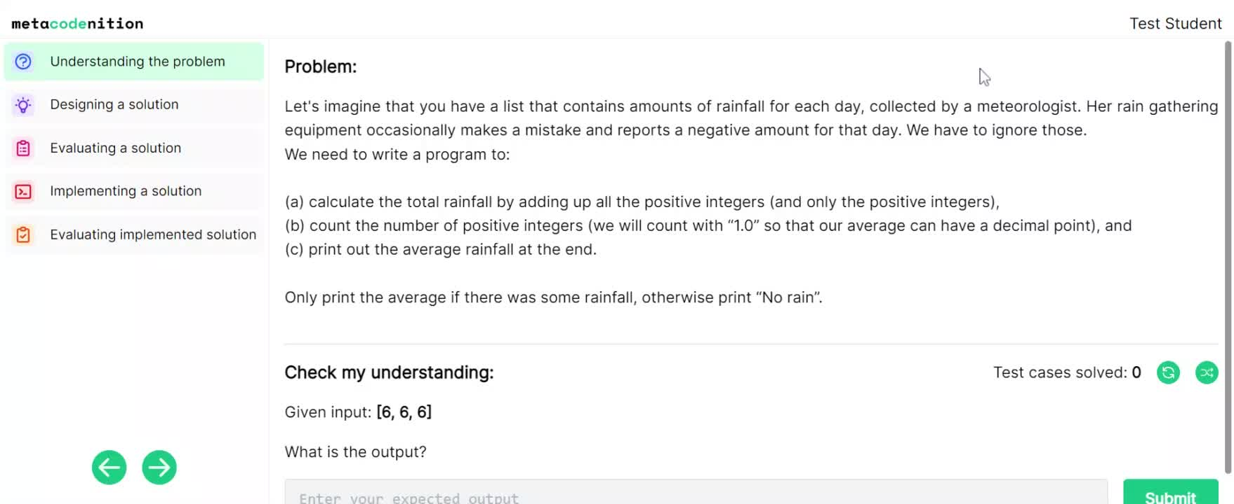
Yulia Pechorina
Notes:
The first page in our IDE is the problem page.
The problem page is designed to help a student understand the problem at hand as well as test their understanding of it.
Over here we have the problem displayed.
Once we have read through the problem, we can solve some test cases to test our understanding. Let's try this out.
DEMO:
simple test case

Slide 8
Problem Page
Question
text
string
testCases
Map<string,string>
defaultListItems
ListItem[]
defaultFile
File
Information about a problem is stored in a Question document.
Yulia Pechorina
Notes:
When designing the problem page, an important part was designing the database schema. We store information about a problem in the questions collection in our Firestore database.
Each Question document has the schema shown on the screen.
A question has text, a map of test cases, a default file of code, and another field which will be explained later.
------------------------
Each Question has some text. It also has a testCases field, which is a Map that has its key as the input, and its value as the expected output.
The purpose of the defaultListItems field will be described later in this video, and the defaultFile is the default code given to the student to act as a starting point.

Slide 9
Problem Page
Question
text
string
testCases
Map<string,string>
defaultListItems
ListItem[]
defaultFile
File
Information about a problem is stored in a Question document.
User
authProvider
string
email
string
name
string
A user's solved test cases are stored in a User document's solvedTestCases field.
uid
string
solvedTestCases
string[]
highlights
Highlight[]
userTestCases
TestCase[]
usedParsonsIds
string[]
Yulia Pechorina
Notes:
A user's solved test cases are stored in a User document's solvedTestCases field.

Slide 10
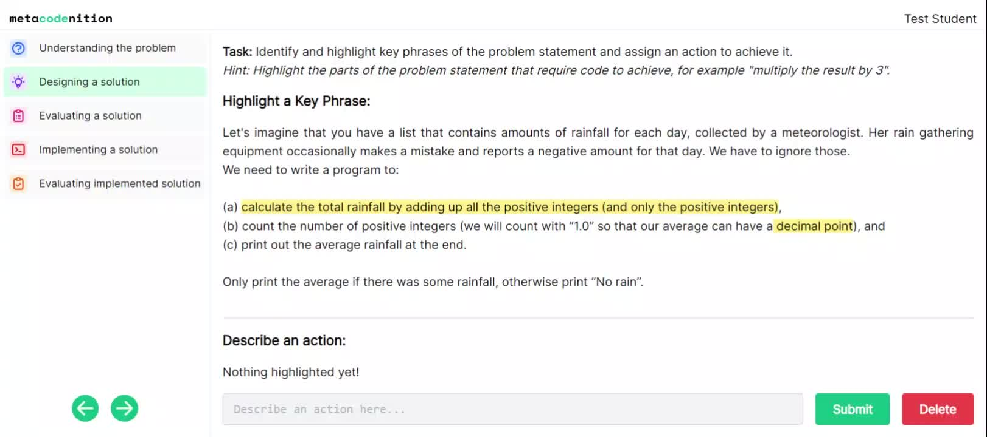
Keith Anderson
Notes:
The designing a solution page allows the student to highlight sections of the problem prompt and associate actions with them.

Slide 11
Design Page
Indices of highlight are calculated
Highlight object is saved to User document
Problem text is sliced according to indices
<mark> and <span> elements are inserted for the highlight and tooltips respectively
Final preformatted HTML string is rendered.
User
authProvider
string
email
string
name
string
uid
string
solvedTestCases
string[]
highlights
Highlight[]
userTestCases
TestCase[]
usedParsonsIds
string[]
Keith Anderson
Notes:
The user's highlights are stored within their user document, and includes the string indexes for where the highlight begins and ends, as well as the associated action.
Detecting what a user has highlighted is achieved through manual traversal through the HTML DOM Tree, visiting the sibling nodes until the start and end indices of the problem statement have been reached.
Markup is inserted at highlight indexes to add the highlighting and annotation for the user.

Slide 12
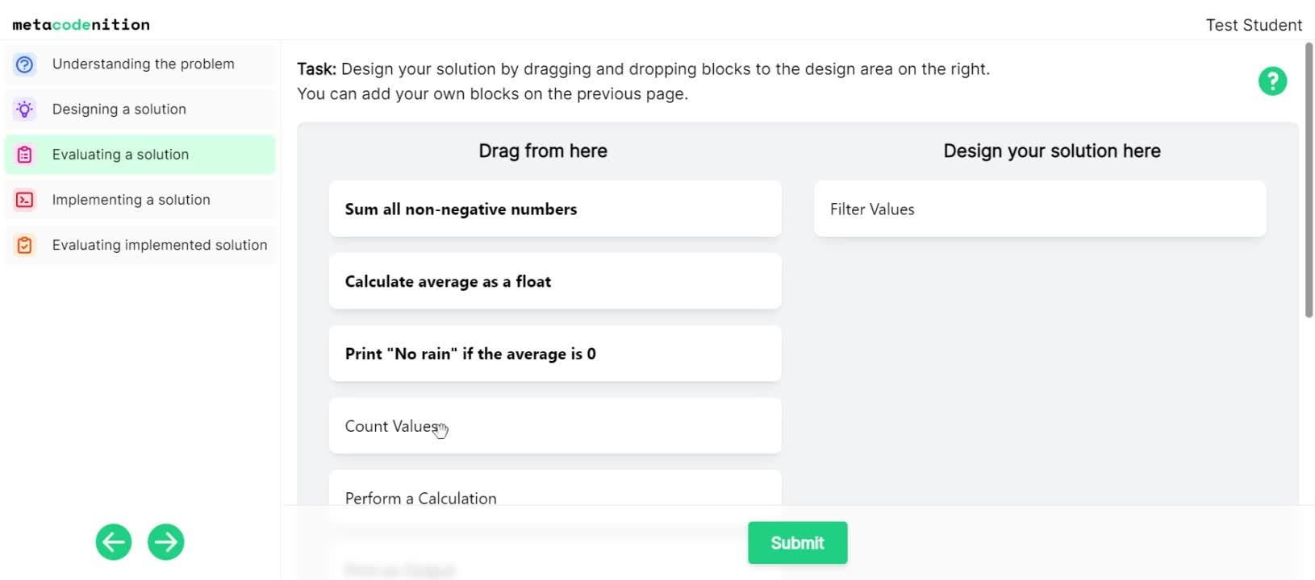
Keith Anderson
Notes:
The evaluating a solution page allows the student to select actions from a list which includes actions they have created, and actions provided by the instructor.
The student can re-arrange these actions to form their final solution design.

Slide 13
Evaluation Page
Question
text
string
testCases
Map<string,string>
defaultListItems
ListItem[]
Default parsons fragments are included in the Question.
Parsons fragments are generated from the actions associated with the User's Highlights.
"Used" fragments are tracked in the User.
defaultFile
File
User
authProvider
string
email
string
name
string
uid
string
solvedTestCases
string[]
highlights
Highlight[]
userTestCases
TestCase[]
usedParsonsIds
string[]
Keith Anderson
Notes:
The instructor's actions are included in the Question while the user's actions are associated with that specific user.
The user object also tracks which actions are used and their order.

Slide 14
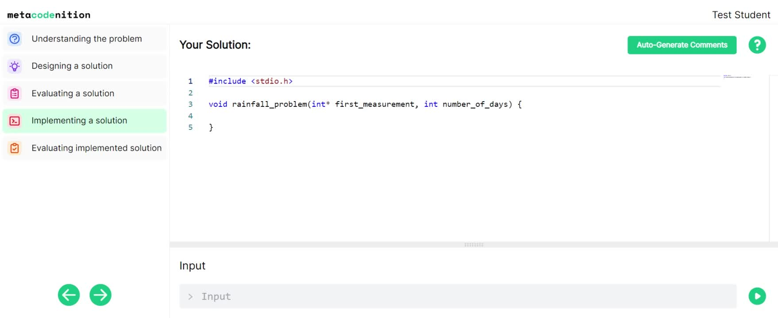
Yulia Pechorina
Notes:
This is the page where a student can begin implementing their solution.
Here we can generate comments from the design constructed on the previous page.
I'm now going to paste in a solution.
Let's run it.
Let's add an input of [1,1]
And the output is 1 - what we expect.
--------------------------
Code editing demo w/ a solution to the rainfall problem.
Code running demo
Show an incomplete solution and the error associated with it
Check the problem again
Fix the error and run again, see the output.

Slide 15
Implementation Page
Uses the Monaco Code Editor and @monaco-editor/react npm package
Yulia Pechorina
Notes:
For the implementation page, we used the Monaco code editor. For easy integration with React, we used the @monaco-editor/react npm package.

Slide 16
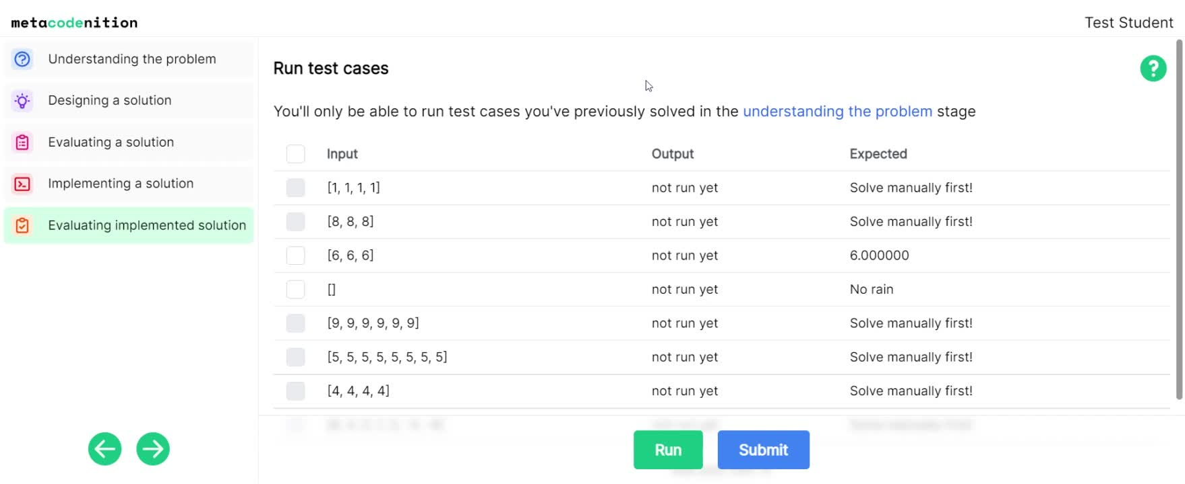
Yulia Pechorina
Notes:
The test-case page allows a student to run their code against provided test cases.
Students can only run test cases that they solved on the problem page. The rest will be disabled.
Let's run them.
One test case failed, let's add some code to our solution to fix this.
Now let's run it again.
All good!
A student can also add their own test case.
Let's add one.
[7, 7, 9, 2]
answer is 6.250000
and we can run that one too
we can also delete it if we like.

Slide 17
Code Runner
Our Code Runner service uses JobeInABox
JobeInABox is an open-source repository that provides a Docker container image for a Jobe Server
Jobe is a server that runs code in various programming languages
Yulia Pechorina
Notes:
To run student code, we used the JobeInABox repository, which provides a Docker container image for a Jobe server. Jobe is a server that allows us to run code in many different programming languages.

Slide 18

Code Runner
Google Cloud Run is used to host JobeInABox containers
We interact with the JobeInABox service through a RESTful API
Yulia Pechorina
Notes:
To host JobeInABox containers, we decided to use Google Cloud Run.
To launch our code runner service, I built the JobeInABox docker image, and then uploaded it to cloud run.
This gives us a publically accessible URL, exposing a REST API for the underlying Jobe server. Cloud Run handles load balancing automatically.

Slide 19

Code Wrapper
Each question requires a wrapper to parse Standard Inputs
Written in C
Can handle a wide range of inputs:
"1, 2, 3"
"1 2 3"
"rain from sensor: 1 2 3"
"[1 2 3]"
Keith Anderson
Notes:
To run the student code submissions, each question requires a code wrapper.
This is to make the logic behind running student code for each submission as generic as possible.
The main task is to parse the inputs, and call the student's function.
The wrapper is written in the question's native language, in this case in C.
For this question, the wrapper can correctly parse a wide range of different input formats, including these.
When the student hits the run button, their code is inserted into the code wrapper, and sent in the payload of an HTTP POST request to the Cloud Run server. The request is then routed to an available Jobe instance.

Slide 20
Thanks for Listening!
Notes:
Thats it.
Thanks for listening to our mid year progress video!

